Slide 1
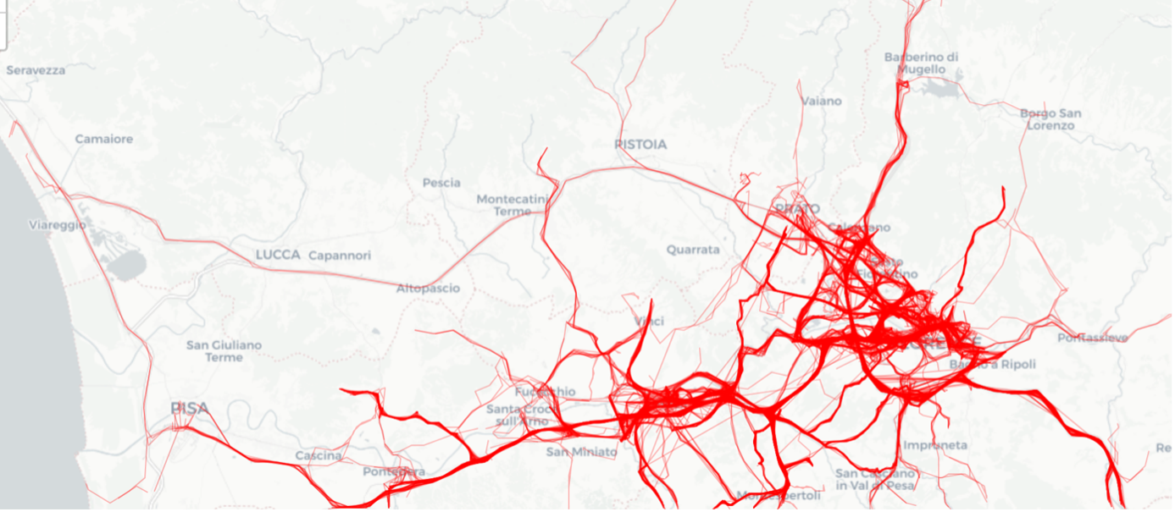


Toward Data-Driven Mobility:
Harnessing Big Data for a Smarter Transport Network in Tuscany
Andrea Vitali
Supervisors:
Dr. Leonardo Piccini (IRPET)
Prof. Mirco Nanni (UNIPI)

Slide 2
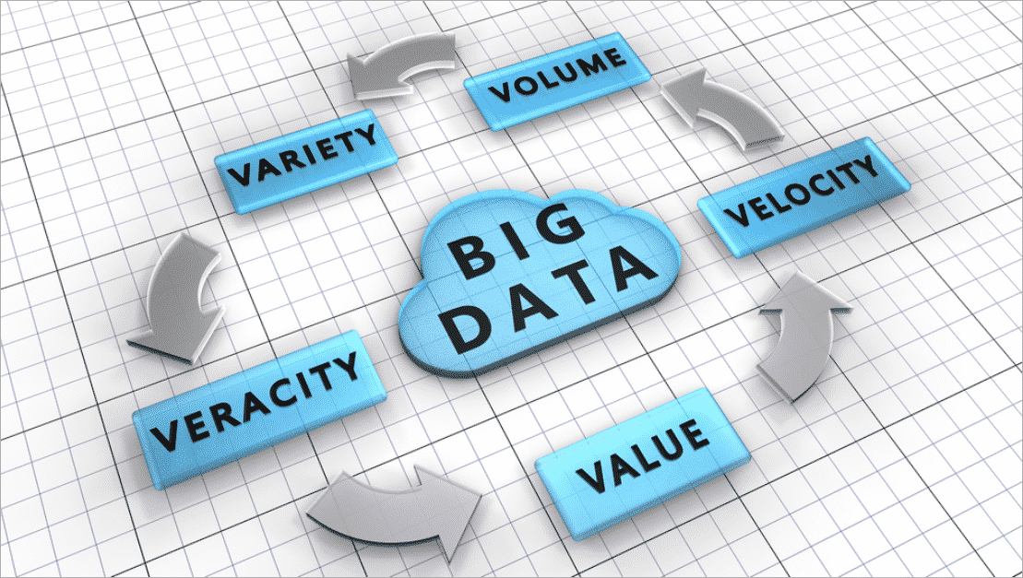

Toward Data-Driven Mobility: Harnessing Big Data for a Smarter Transport Network in Tuscany
3rd March 2025

Slide 3

The Importance of Mobility
Mobility goes beyond the logistical issue of moving people and goods from A to B
Toward Data-Driven Mobility: Harnessing Big Data for a Smarter Transport Network in Tuscany
3rd March 2025

Slide 4

The Importance of Mobility
Mobility as a Catalyst for Growth Connected areas foster socio-economic development, while isolated regions face barriers to jobs, healthcare, and education.
Bridging Social Divides and Creating a Fairer Society Improved mobility reduces disparities and ensures equal access to opportunities. It promotes social equity and economic inclusion.
Toward Data-Driven Mobility: Harnessing Big Data for a Smarter Transport Network in Tuscany
3rd March 2025

Slide 5
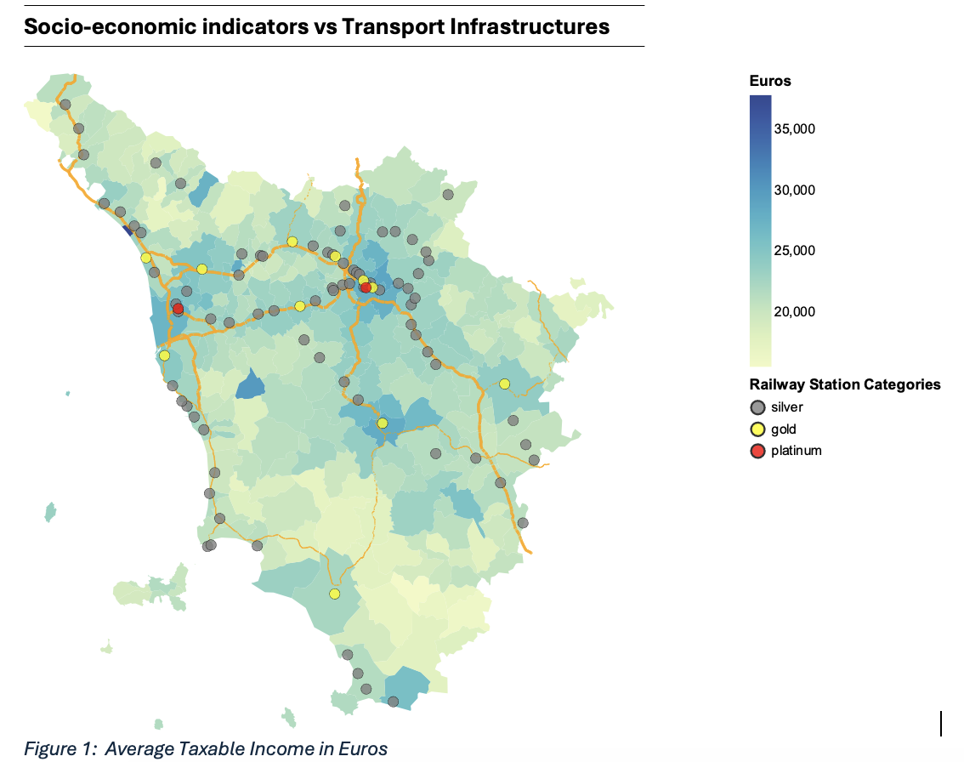
The Importance of Mobility
Socio-Economic Indicators Vs Infrastructures
Toward Data-Driven Mobility: Harnessing Big Data for a Smarter Transport Network in Tuscany
3rd March 2025

Slide 6
The Purpose of the Project
The True Value of Infrastructure – Transport infrastructure is only as effective as its ability to serve its users. Poor planning and management can lead to inefficiency and wasted resources.
Data-Driven Decision Making – Big data and machine learning are transforming infrastructure planning by enabling accurate analysis, pattern detection, and demand forecasting for smarter transport systems.
Project Scope & Key Datasets – This project used two main dataset–mobile phone records and GPS-based vehicle data–to showcase a suite of data-driven tools that policymakers in Tuscany can use to design a more efficient transport system
Toward Data-Driven Mobility: Harnessing Big Data for a Smarter Transport Network in Tuscany
3rd March 2025

Slide 7

A Region-wide Perspective
The Need for a Broader Perspective – Isolated transport planning focusing only on local needs can lead to inefficiencies and wasted resources. A region-wide approach ensures alignment with broader mobility goals.
Big Data & Visualisation for Smarter Decisions – Data manipulations and visualisations can provide policymakers with insights into movement dynamics with more immediacy that tabular data ever could.
A Broader and Holistic View- Combining visualization tools provides administrators with a comprehensive understanding of movement dynamics, enabling data-driven transportation planning that aligns local needs with regional objectives
Toward Data-Driven Mobility: Harnessing Big Data for a Smarter Transport Network in Tuscany
3rd March 2025

Slide 8
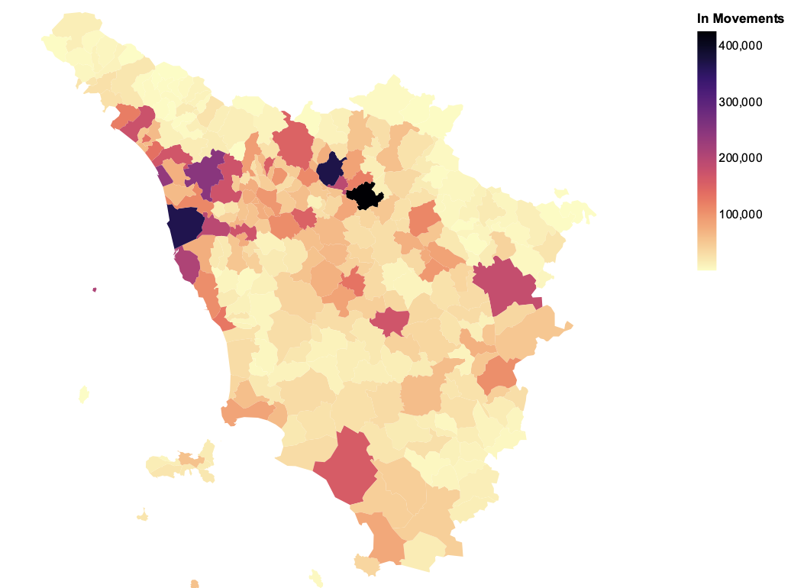
Mapping Large-Scale Movement
Toward Data-Driven Mobility: Harnessing Big Data for a Smarter Transport Network in Tuscany
3rd March 2025

Slide 9
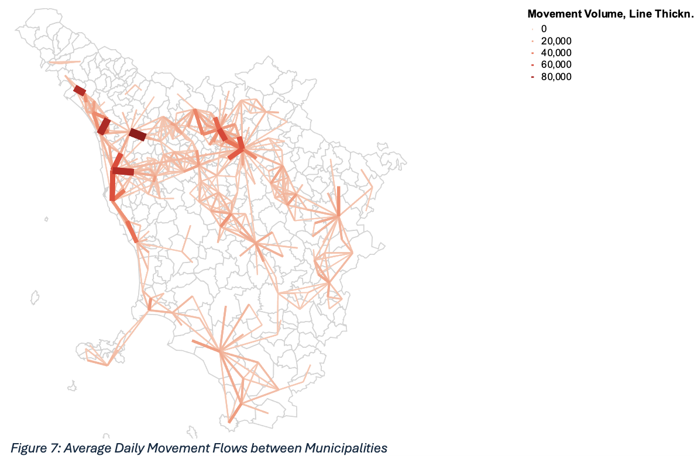
Mapping Large-Scale Movement
Average Daily Flows
Toward Data-Driven Mobility: Harnessing Big Data for a Smarter Transport Network in Tuscany
3rd March 2025

Slide 10
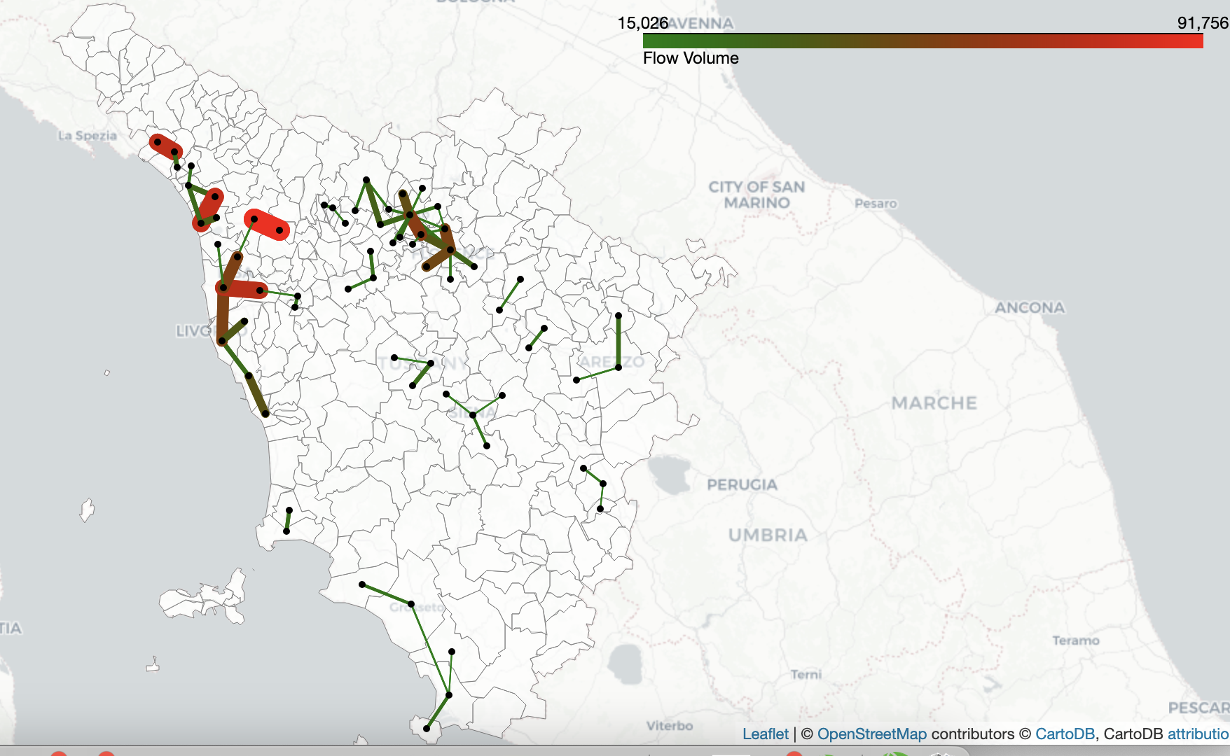
Mapping Large-Scale Movement
Average Daily Flows
Toward Data-Driven Mobility: Harnessing Big Data for a Smarter Transport Network in Tuscany
3rd March 2025

Slide 11
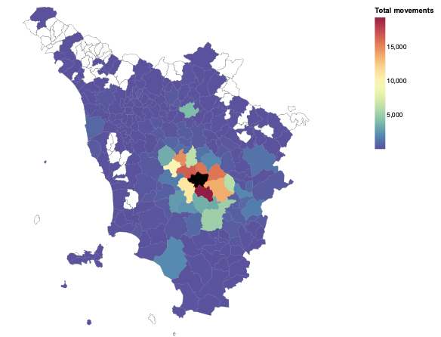
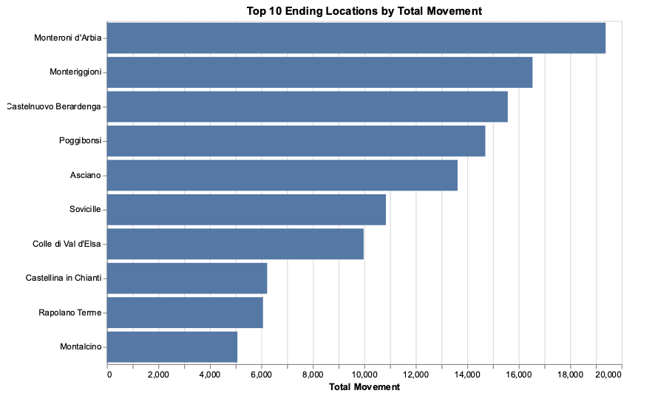
Mapping Large-Scale Movement
Interactive Outbounds movements
Toward Data-Driven Mobility: Harnessing Big Data for a Smarter Transport Network in Tuscany
3rd March 2025

Slide 12
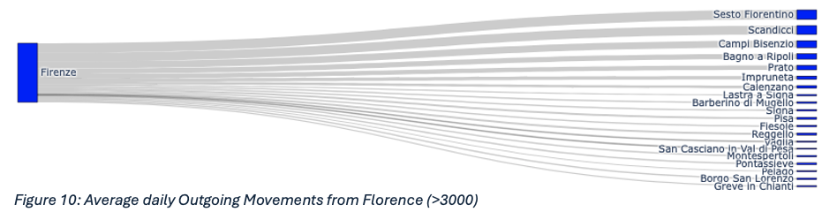
Mapping Large-Scale Movement
Toward Data-Driven Mobility: Harnessing Big Data for a Smarter Transport Network in Tuscany
3rd March 2025

Slide 13
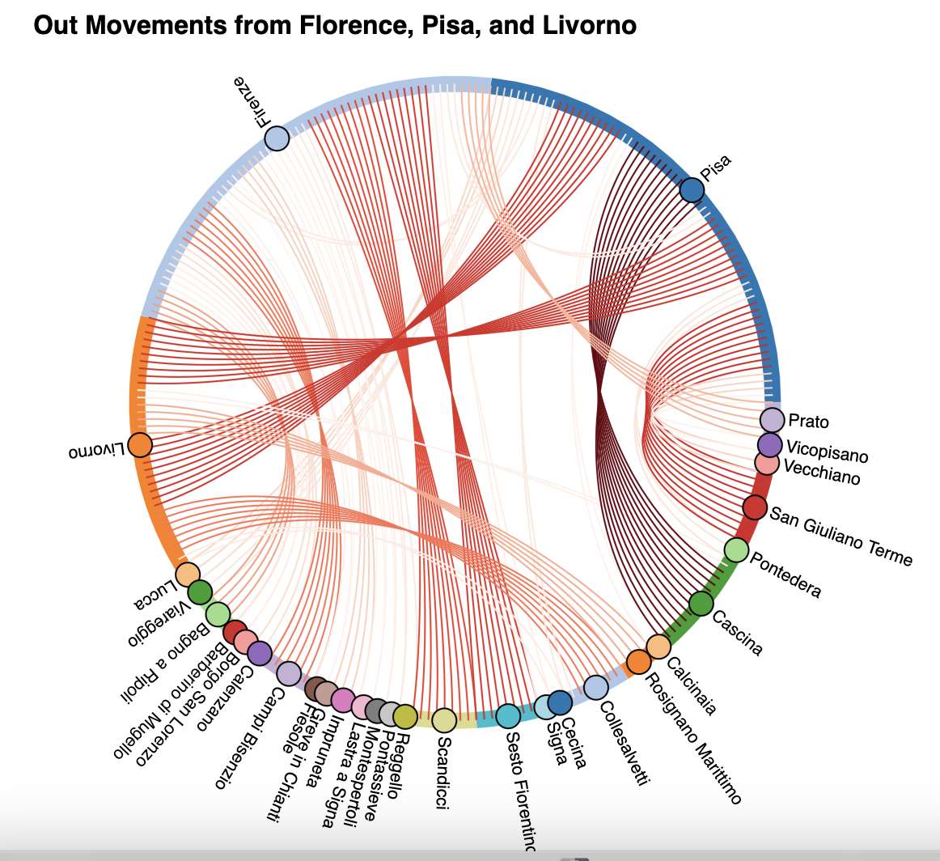
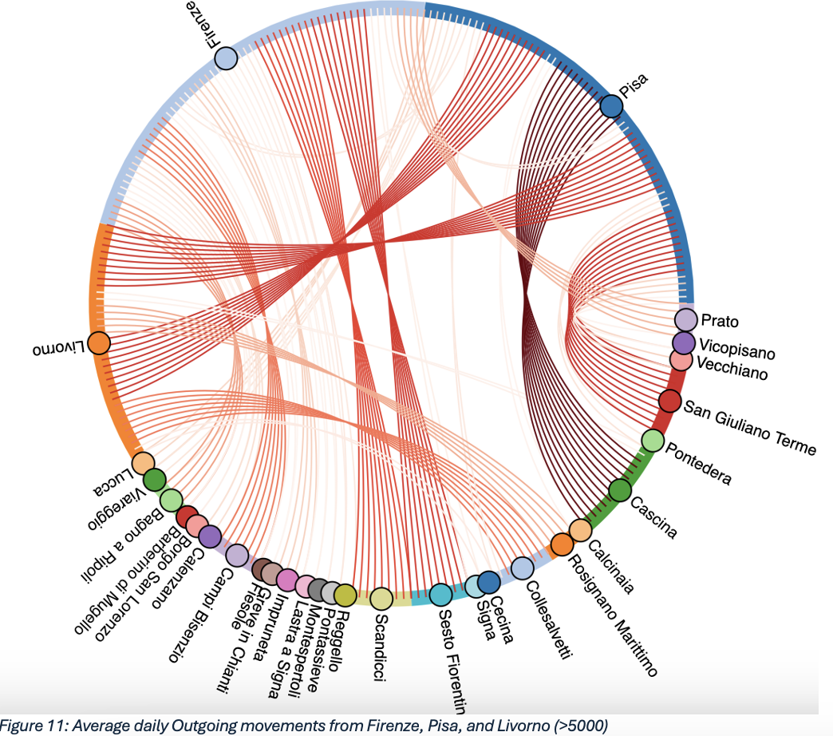
Mapping Large-Scale Movement
Chord Diagram
Toward Data-Driven Mobility: Harnessing Big Data for a Smarter Transport Network in Tuscany
3rd March 2025

Slide 14
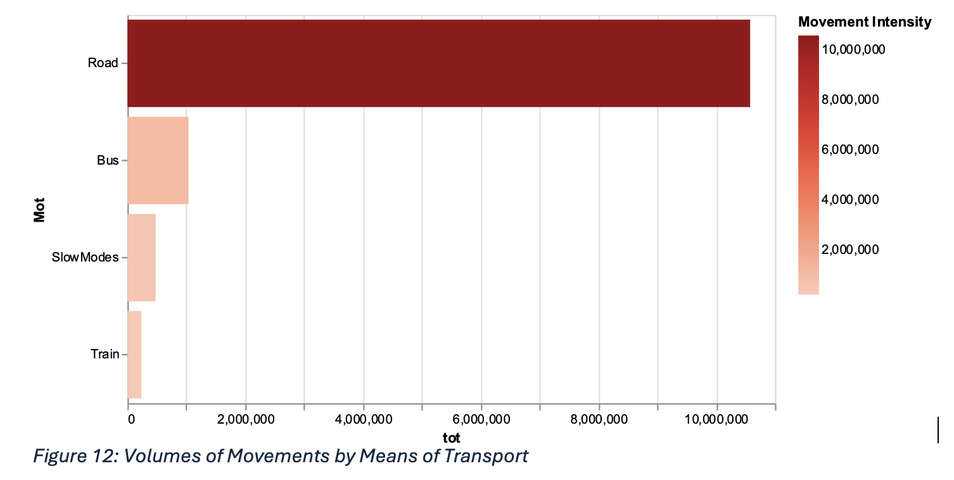
Understanding Modes of Transport
Average Regional Movements by MOT
Toward Data-Driven Mobility: Harnessing Big Data for a Smarter Transport Network in Tuscany
3rd March 2025

Slide 15
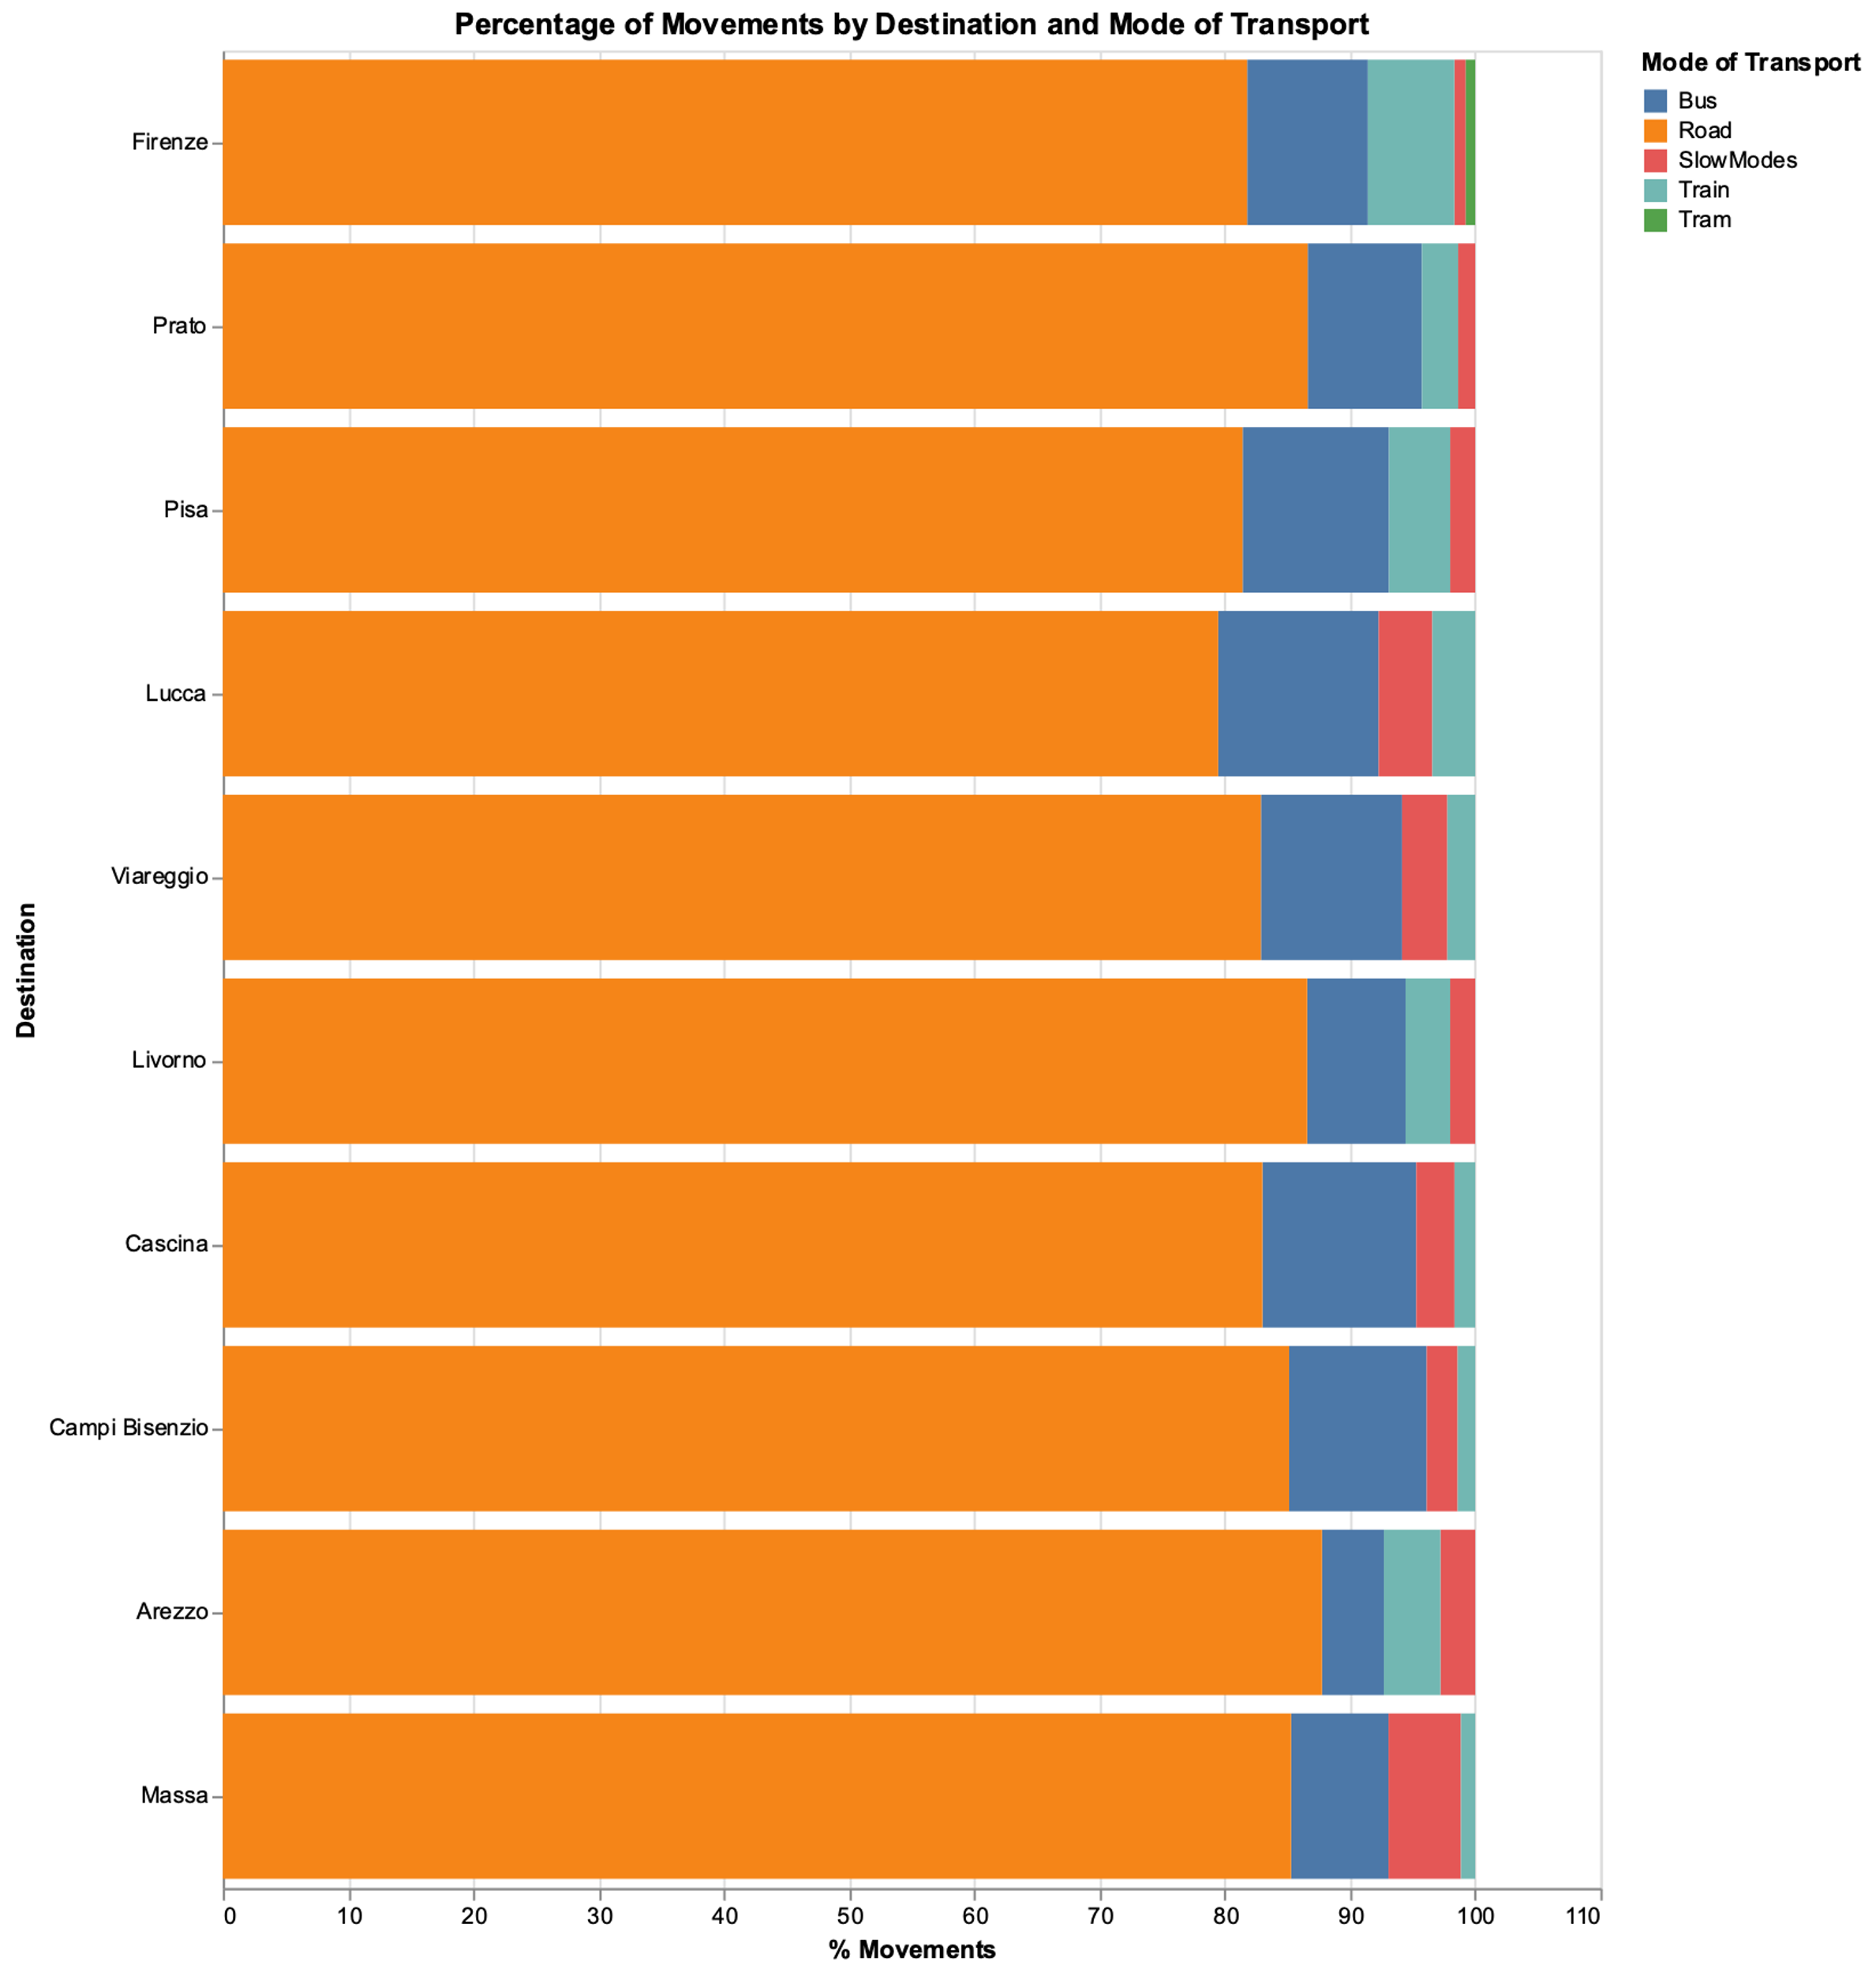
Understanding Modes of Transport
MOT in Top 10 municipalities
Toward Data-Driven Mobility: Harnessing Big Data for a Smarter Transport Network in Tuscany
3rd March 2025

Slide 16
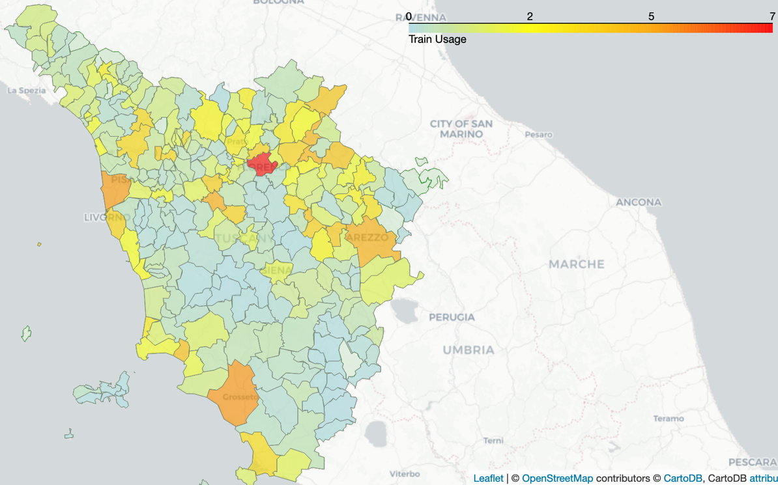
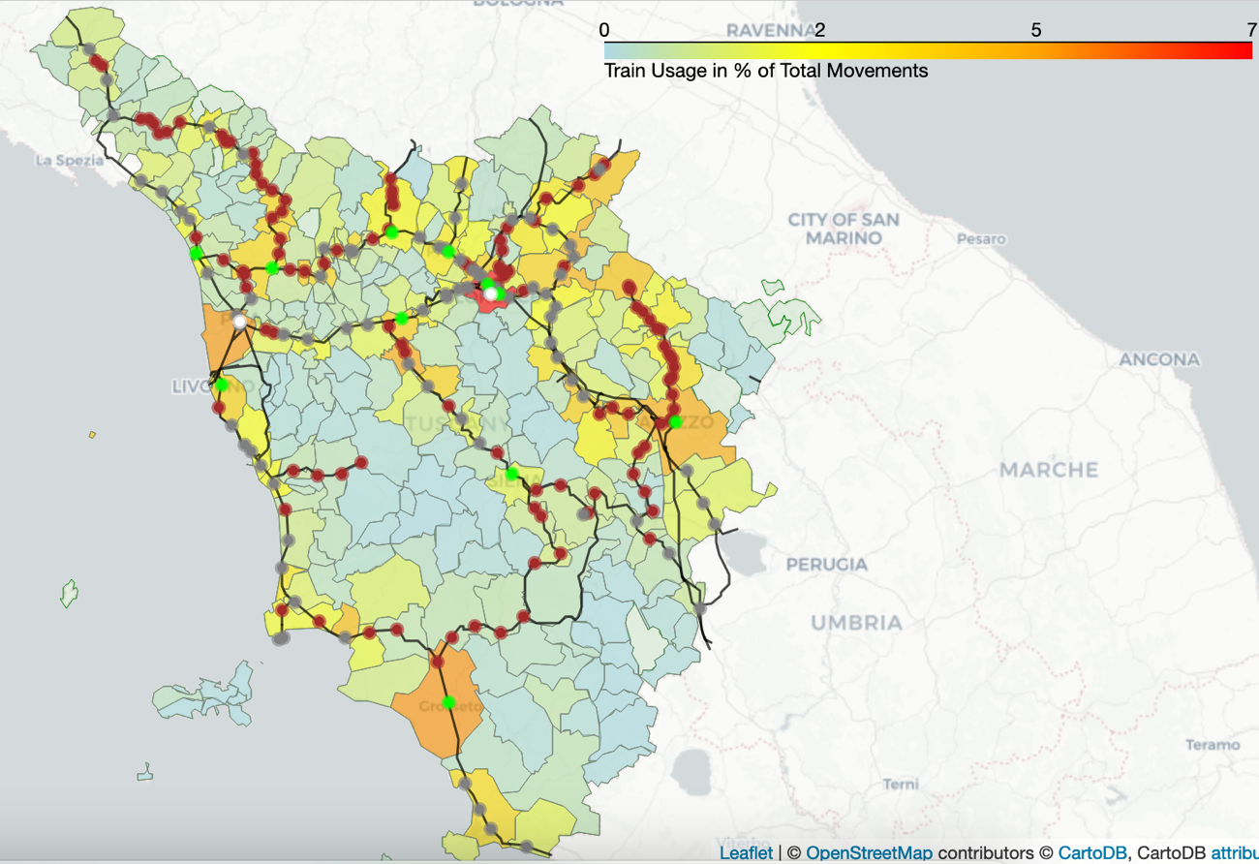
Understanding Modes of Transport
Choropleth Train Usage
Toward Data-Driven Mobility: Harnessing Big Data for a Smarter Transport Network in Tuscany
3rd March 2025

Slide 17
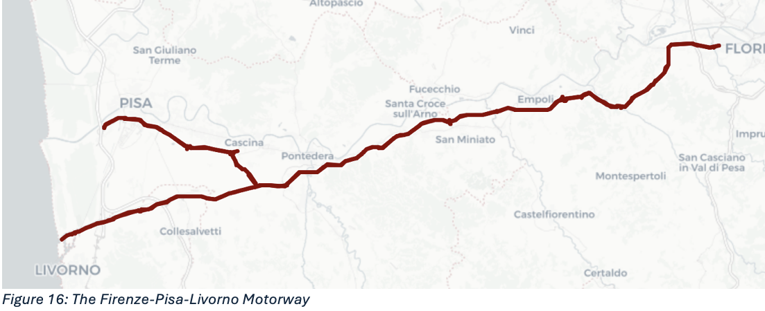
A more Detailed Perspective: the FI-PI-LI motorway
Granular Analysis for Local Insights – Focusing on specific infrastructures or sections allows for a more detailed examination of local issues and opportunities.
Challenges of the FI-PI-LI Motorway – The no-toll Firenze-Pisa-Livorno (FI-PI-LI) motorway, built in the 1960s, is notorious for heavy traffic and insufficient safety features, leading to frequent congestion and accidents with widespread effects on the regional network.
Toward Data-Driven Mobility: Harnessing Big Data for a Smarter Transport Network in Tuscany
3rd March 2025

Slide 18
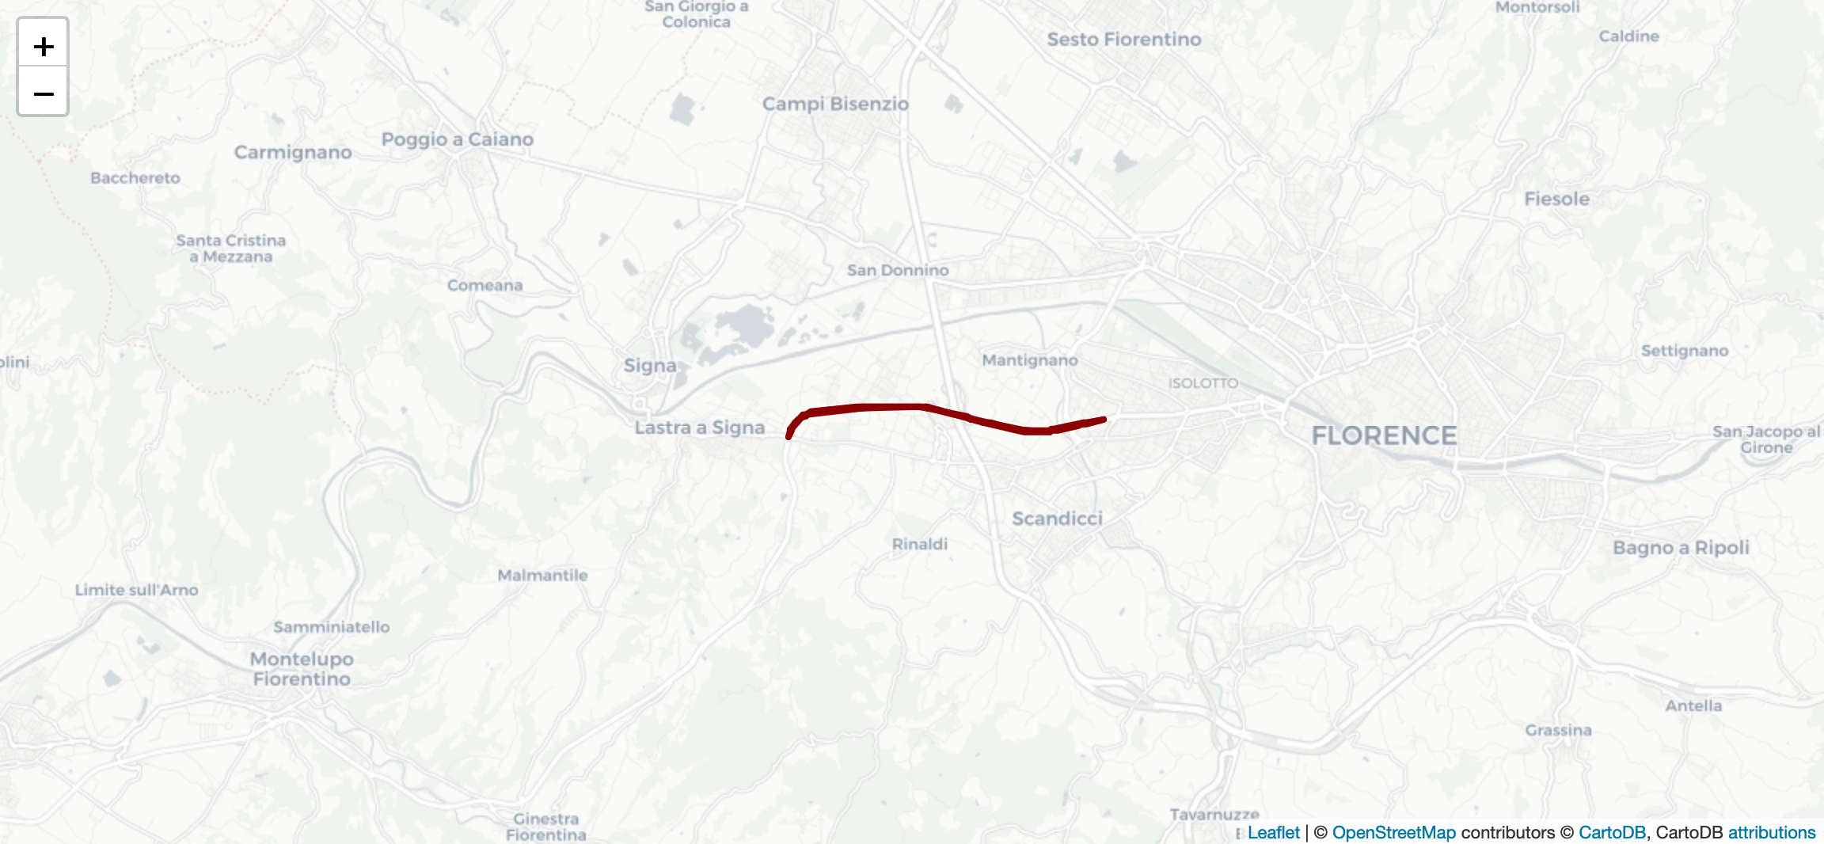
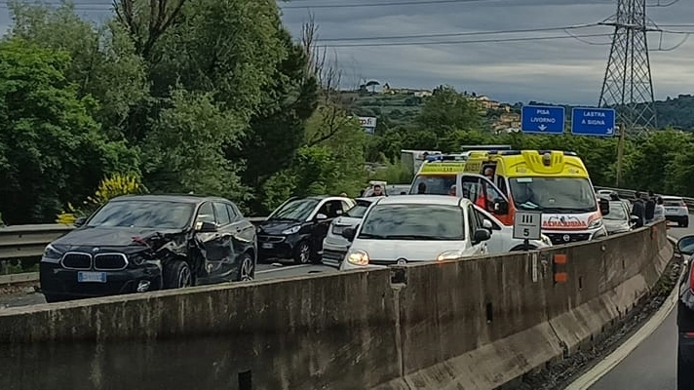

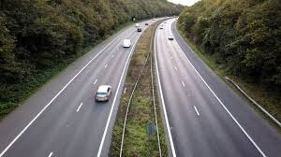

A more Detailed Perspective: the FI-PI-LI motorway
The Lastra a Signa–Florence Segment- One of the busiest and most accident-prone sections of the FI-PI-LI, serving as a key connection between the motorway and the A1 MILANO-NAPOLI.
Data-Driven Solutions for Mobility- Analysis of commuting patterns, traffic flows, and driver behaviours could help identifying congestion causes and inefficiencies, allowing policymakers to develop targeted improvements.
Toward Data-Driven Mobility: Harnessing Big Data for a Smarter Transport Network in Tuscany
3rd March 2025

Slide 19
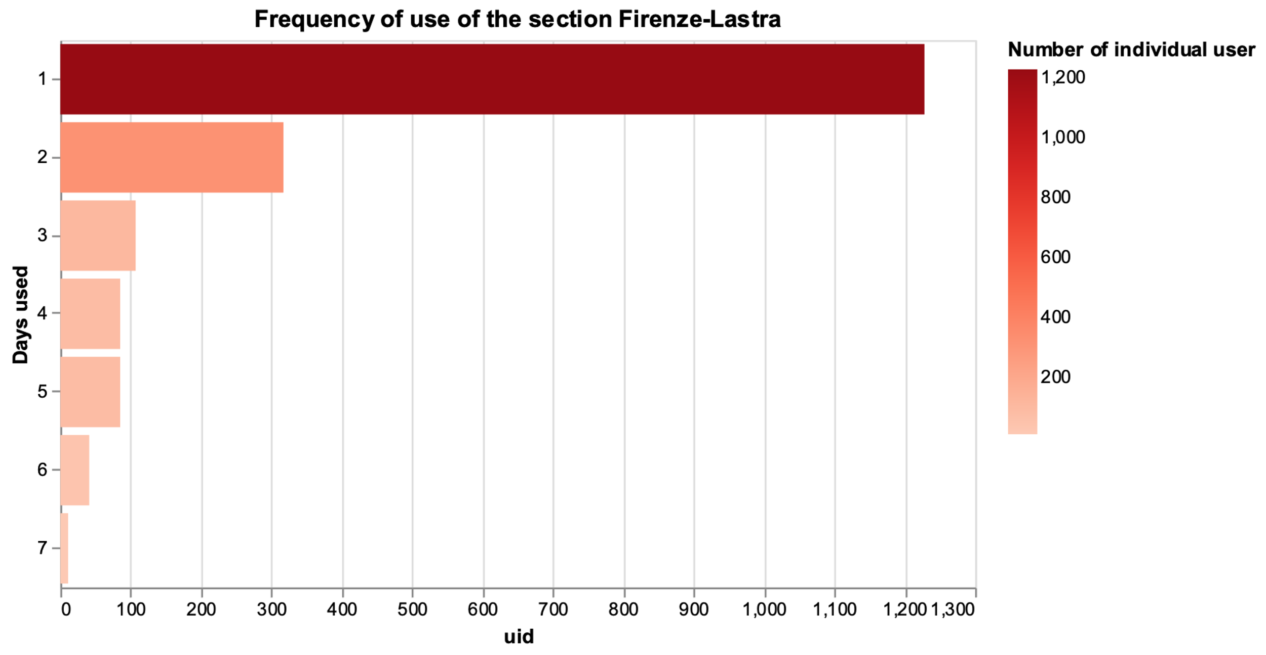
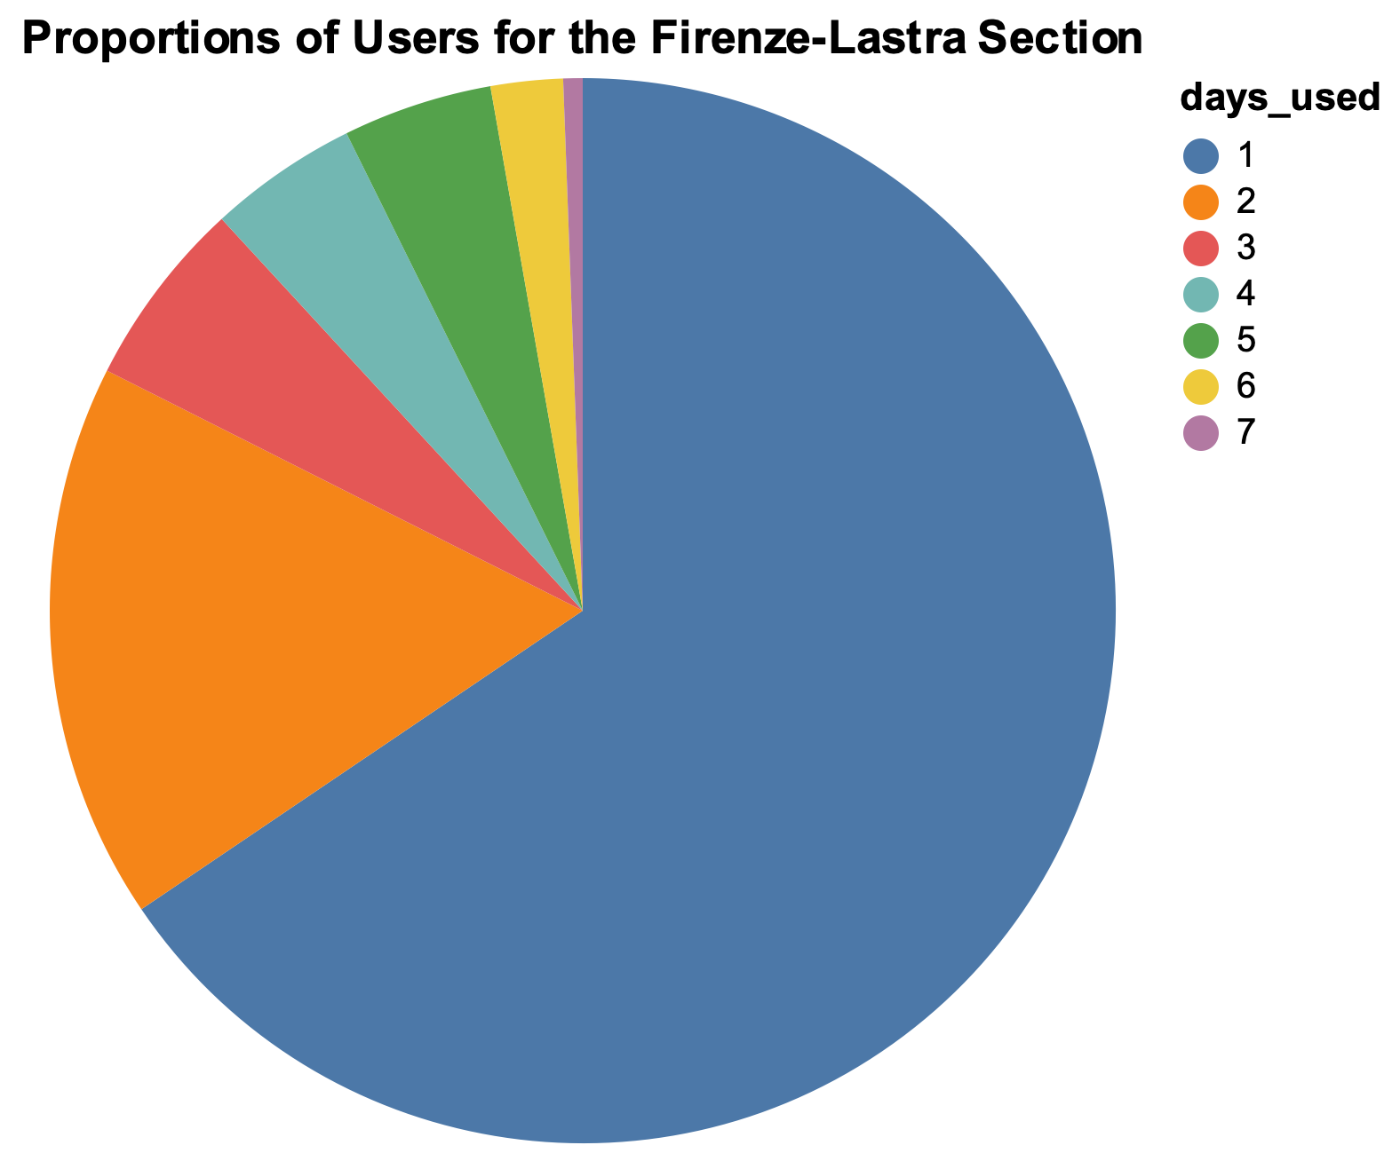
User Analysis: Who’s Driving and When?
Toward Data-Driven Mobility: Harnessing Big Data for a Smarter Transport Network in Tuscany
3rd March 2025

Slide 20
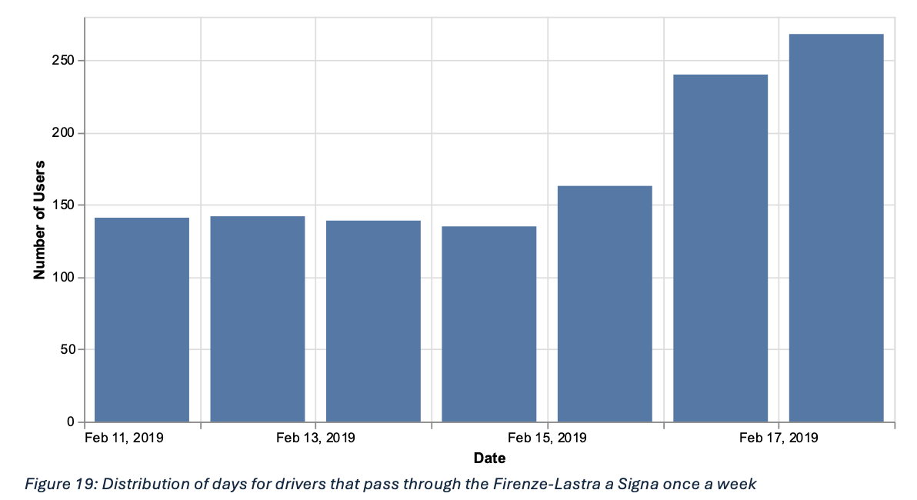
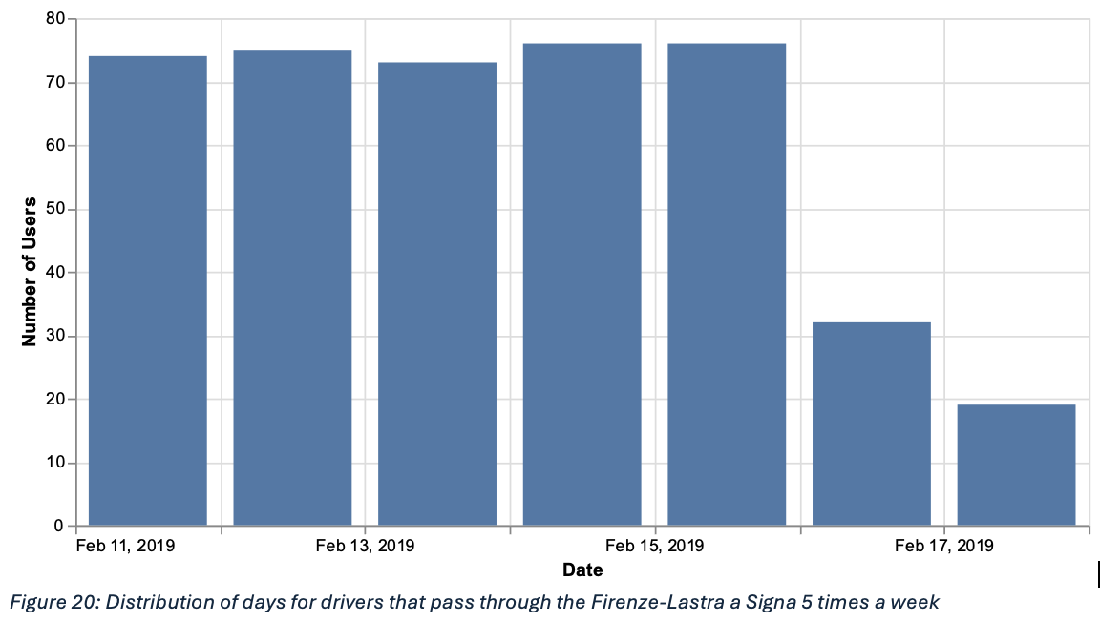
User Analysis: Who’s Driving and When?
Toward Data-Driven Mobility: Harnessing Big Data for a Smarter Transport Network in Tuscany
3rd March 2025

Slide 21
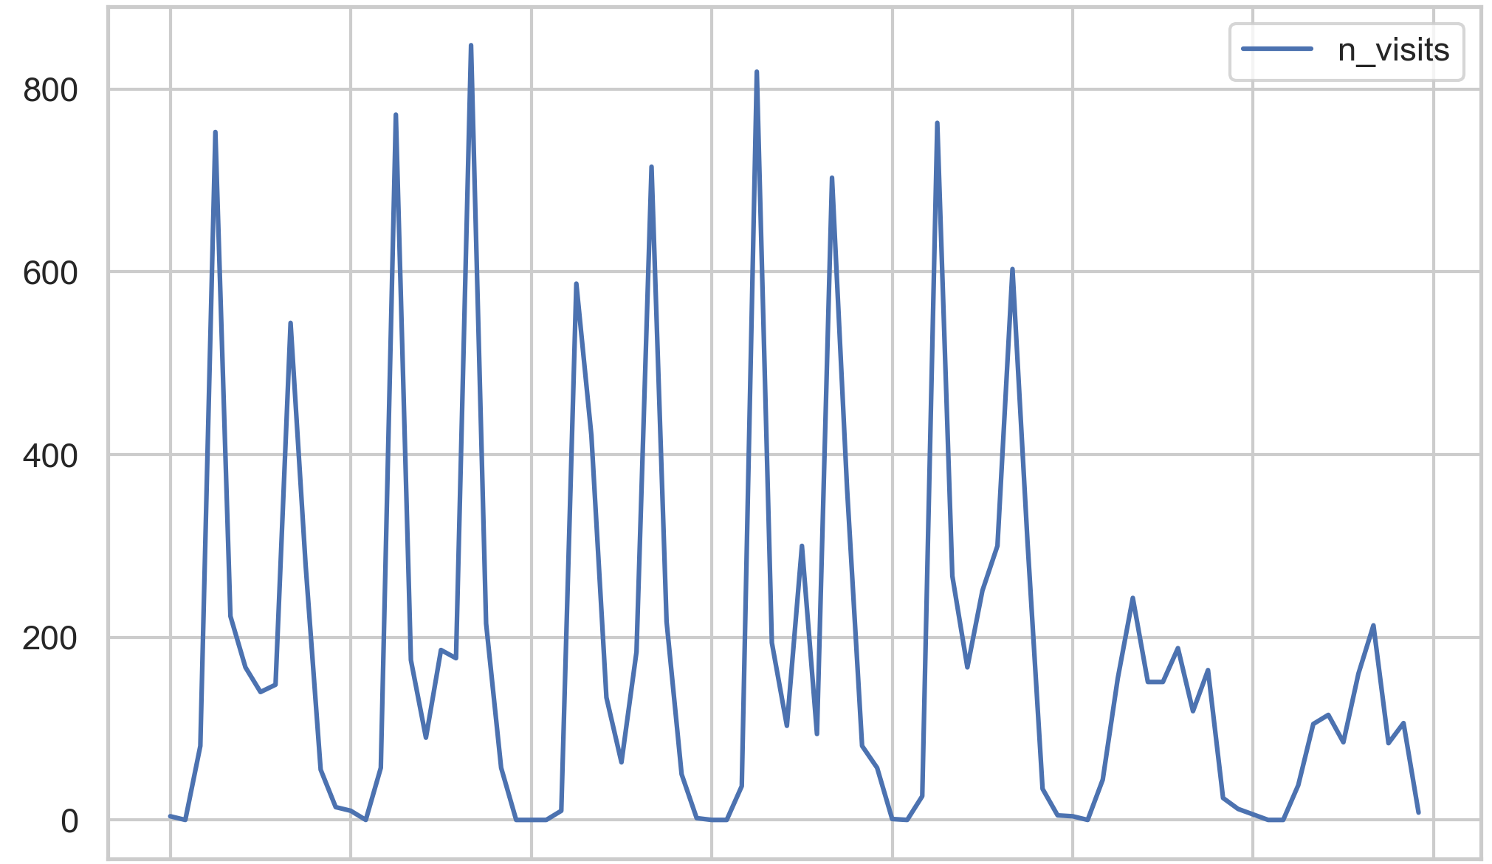
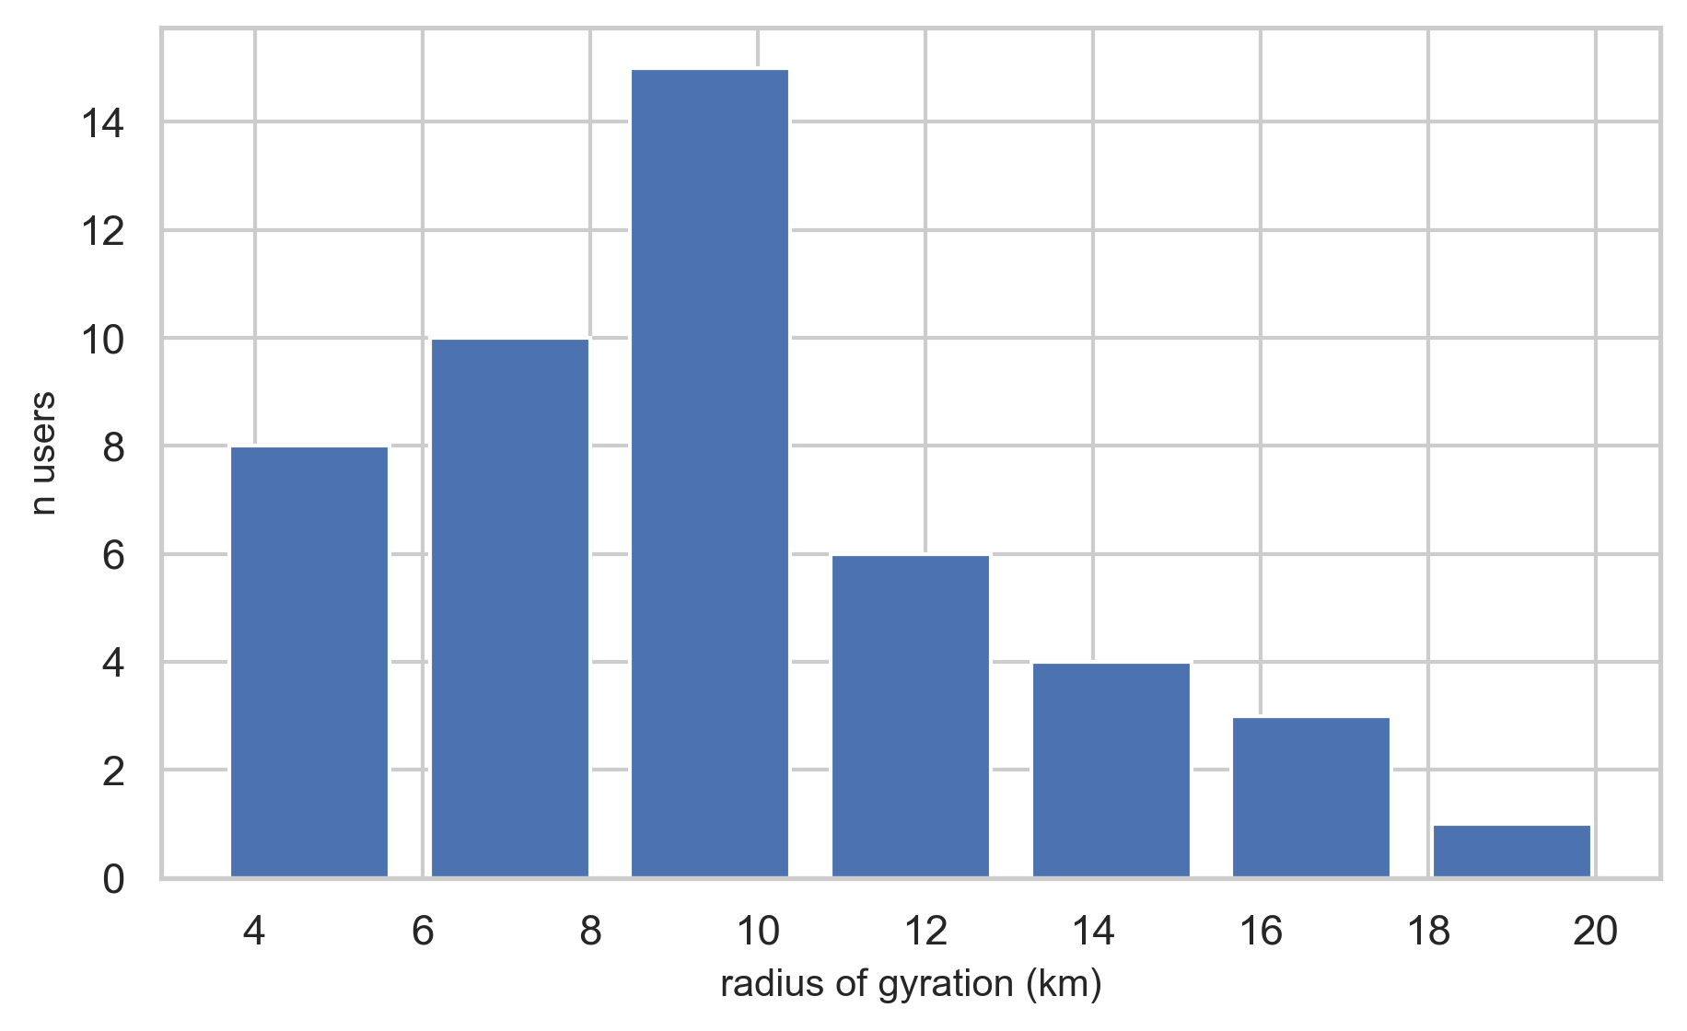
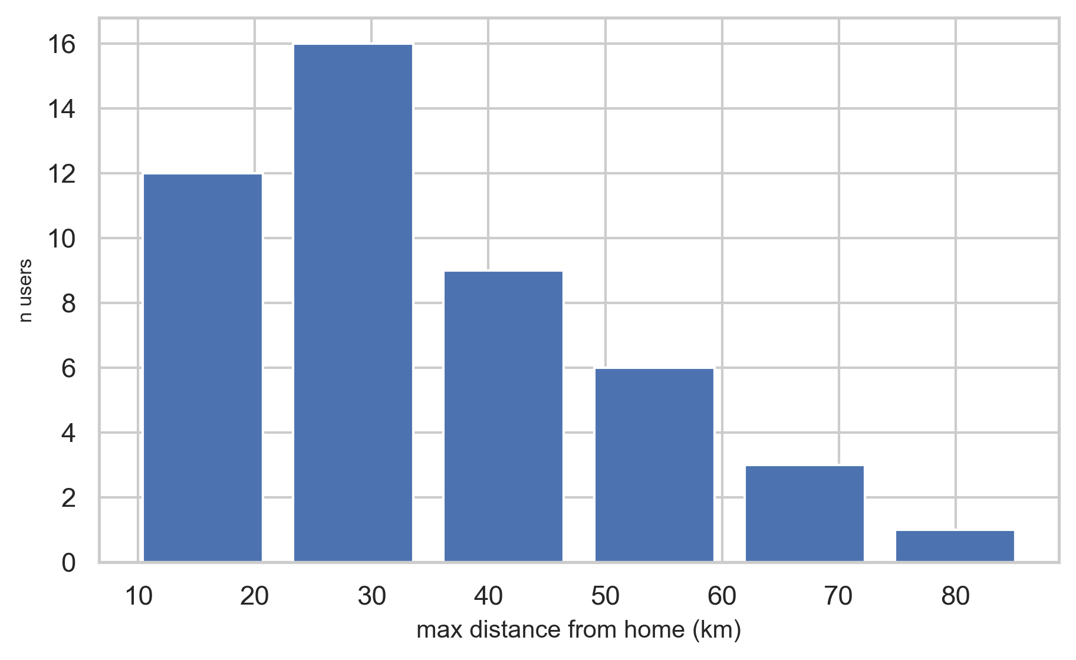
Commuter Behaviour: What Data Tell Us
Rush Hours Dominate
Short Distances
Predictable Mobility
Enhanced Public Transport
Congestion Charges
Flexible Work Schedules
Toward Data-Driven Mobility: Harnessing Big Data for a Smarter Transport Network in Tuscany
3rd March 2025

Slide 22
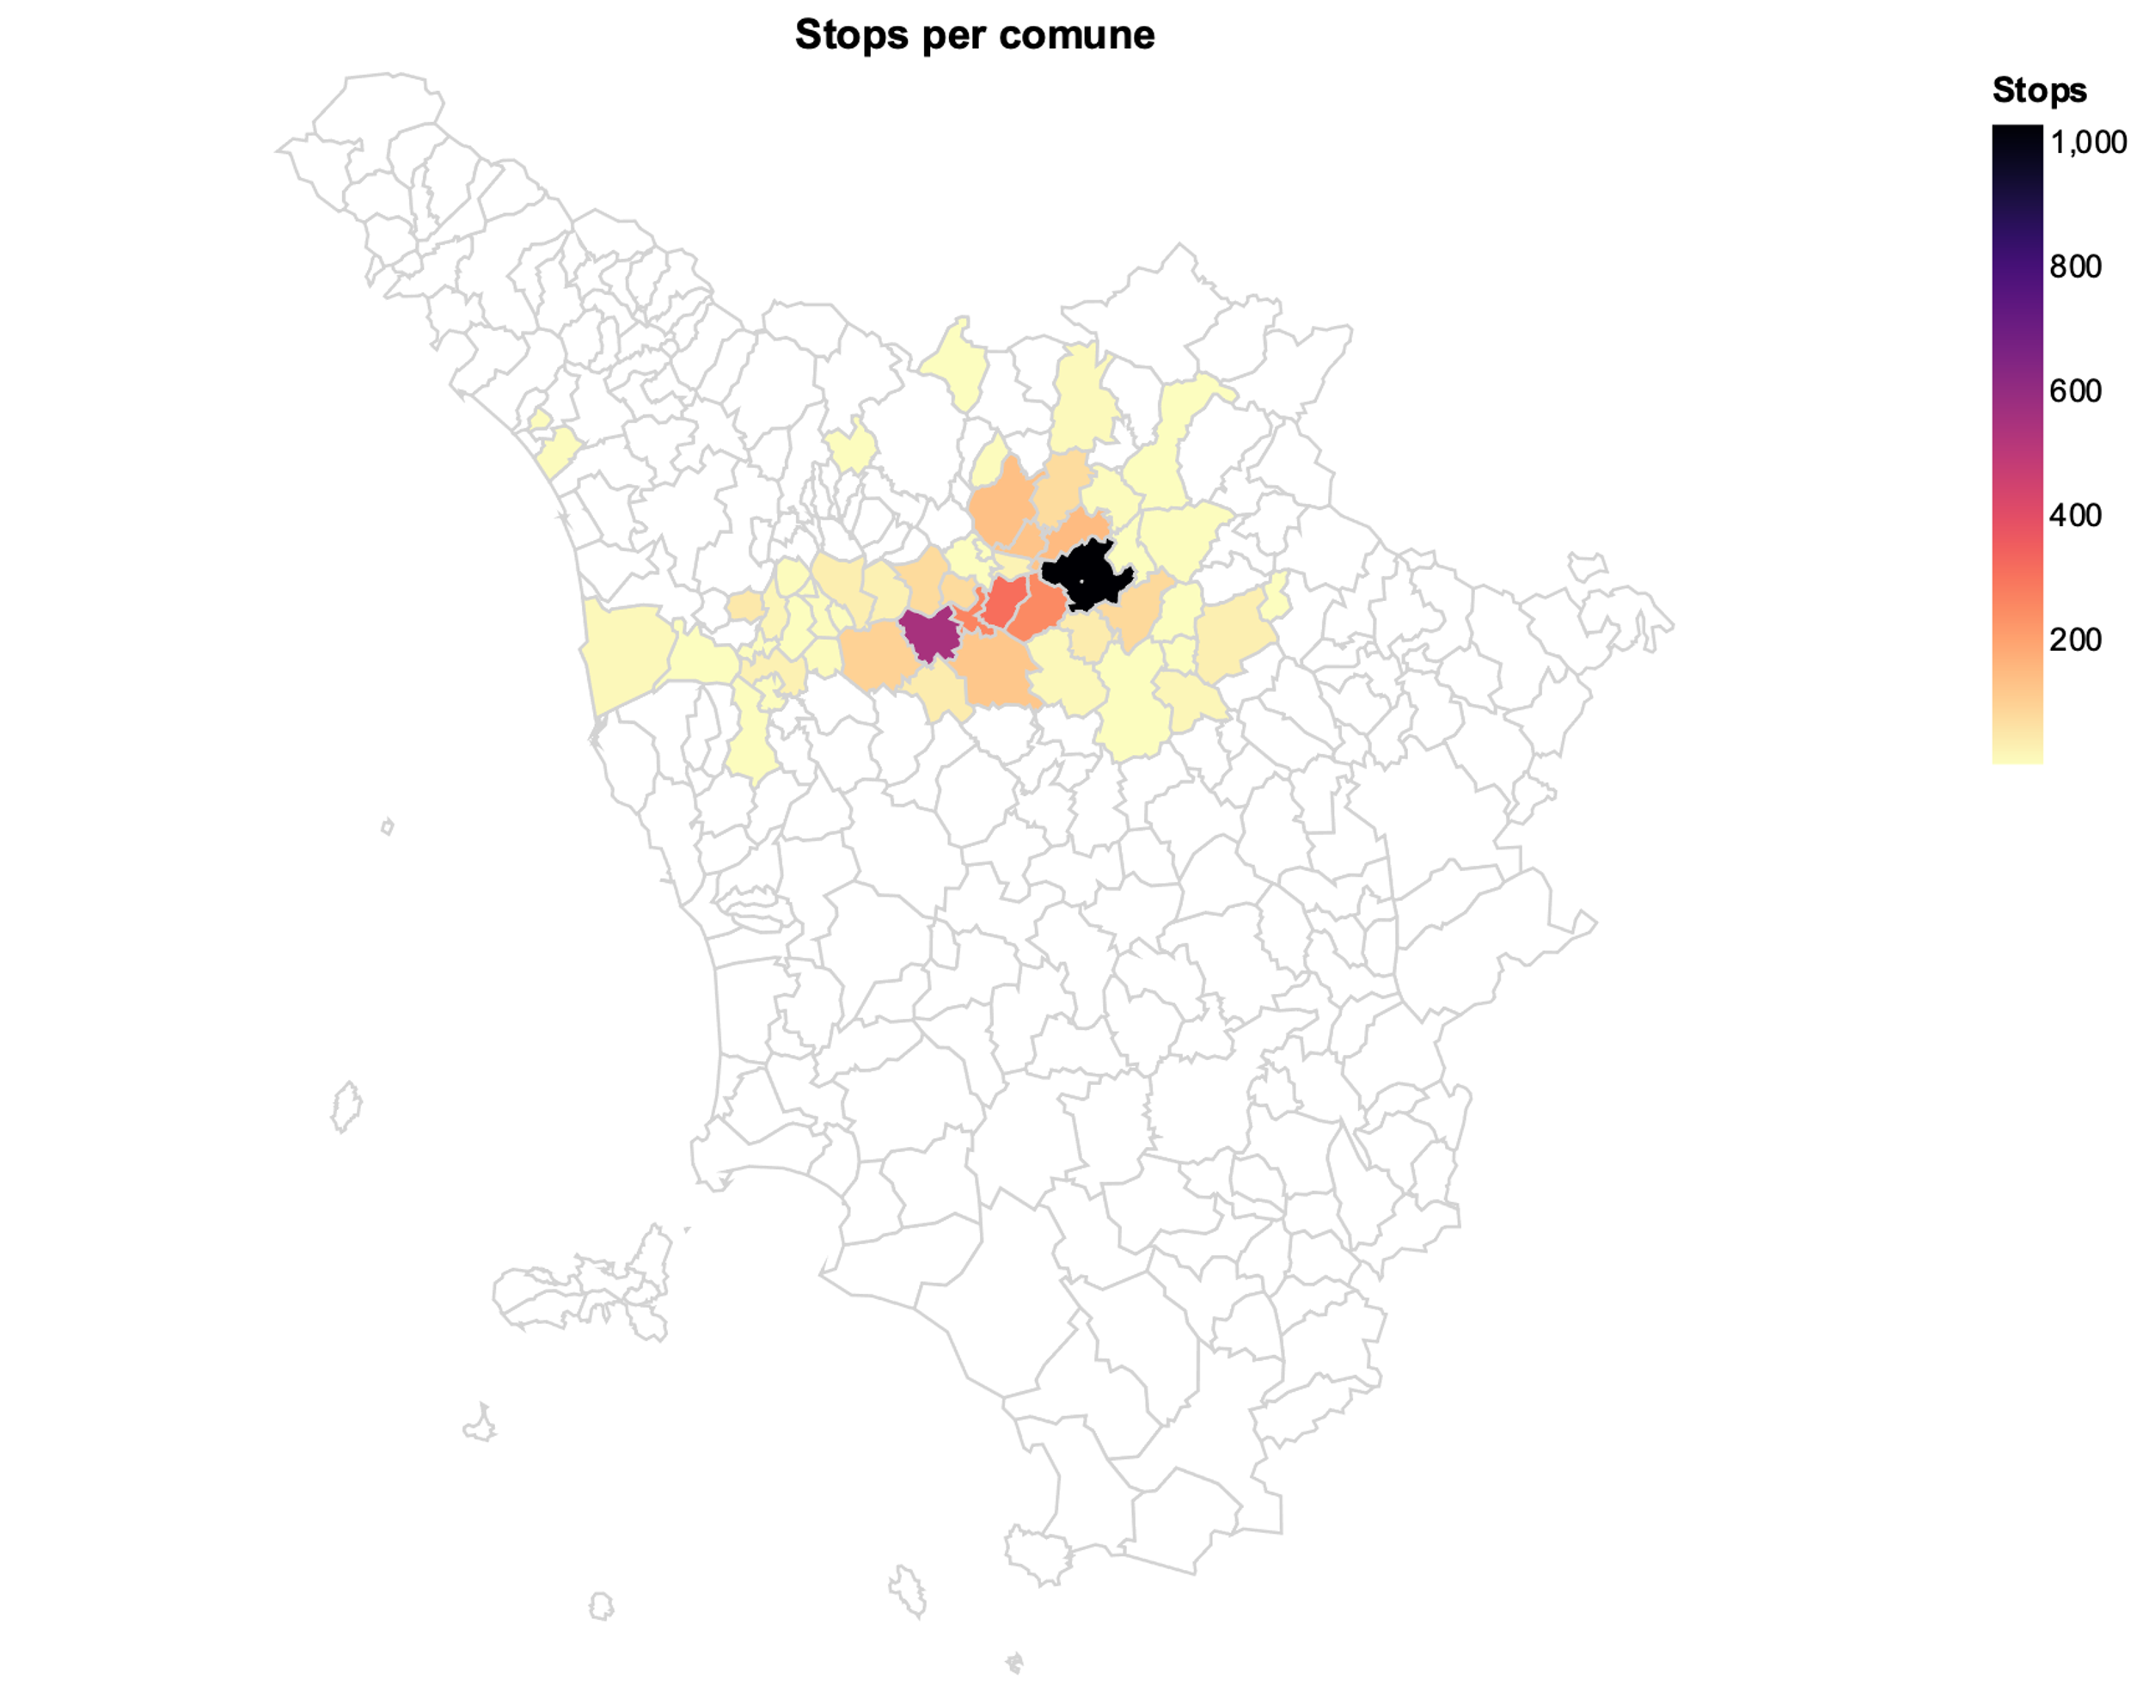
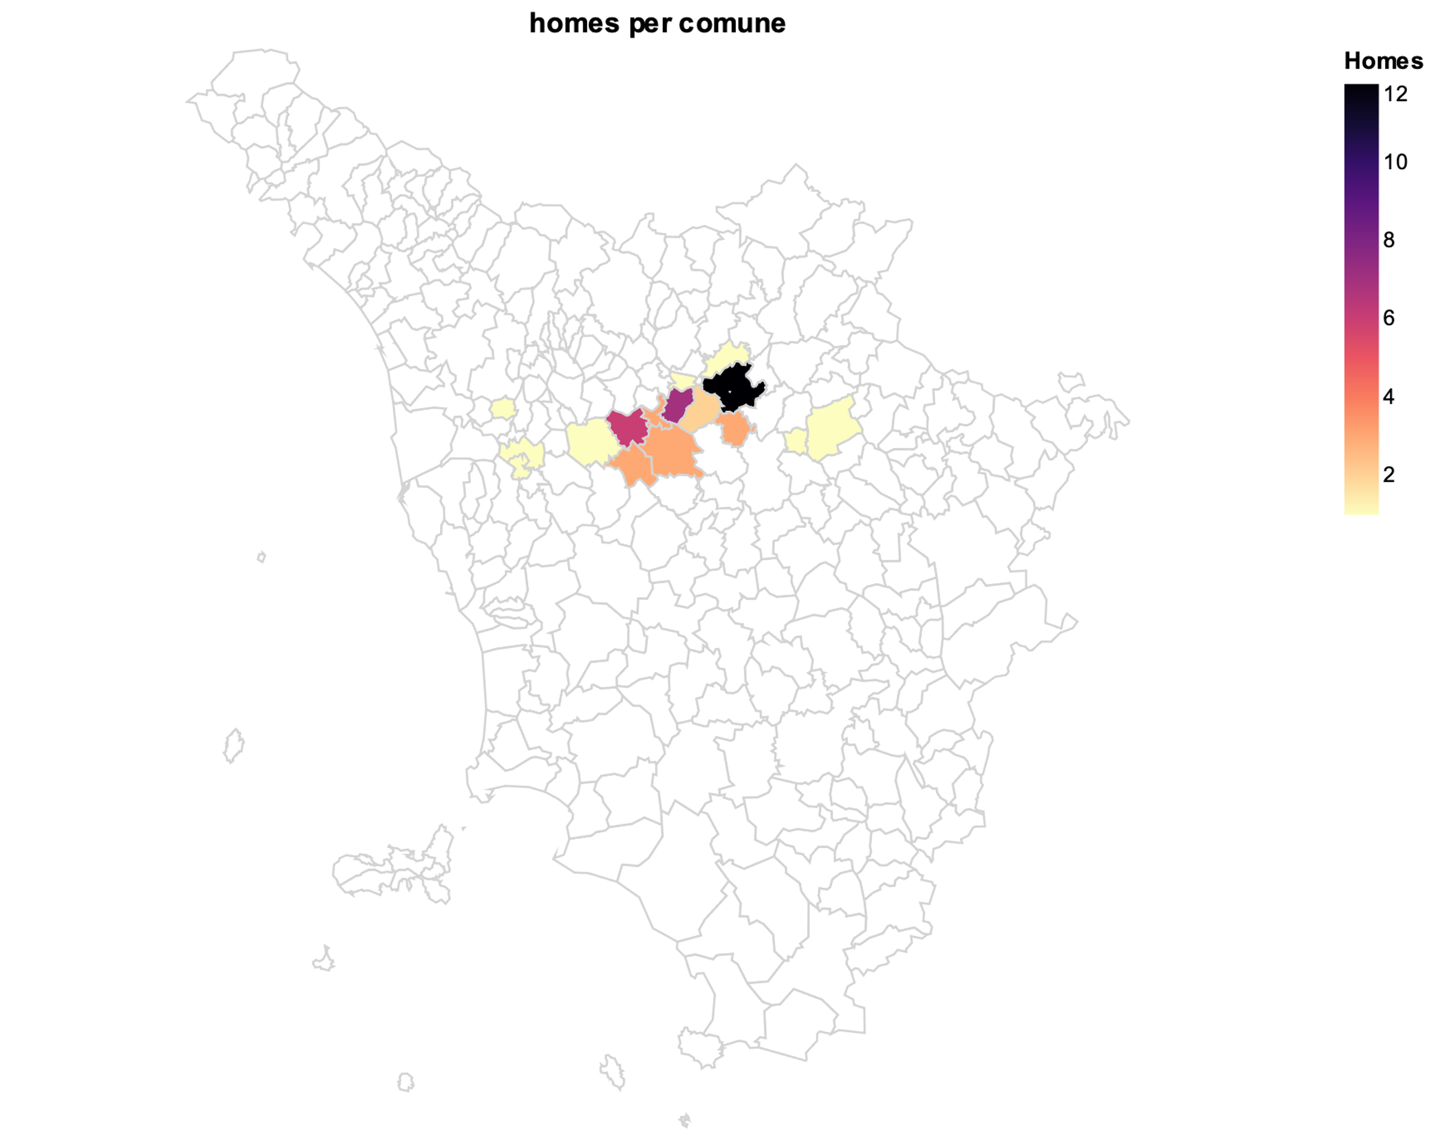
Mapping stops and homes
Toward Data-Driven Mobility: Harnessing Big Data for a Smarter Transport Network in Tuscany
3rd March 2025

Slide 23
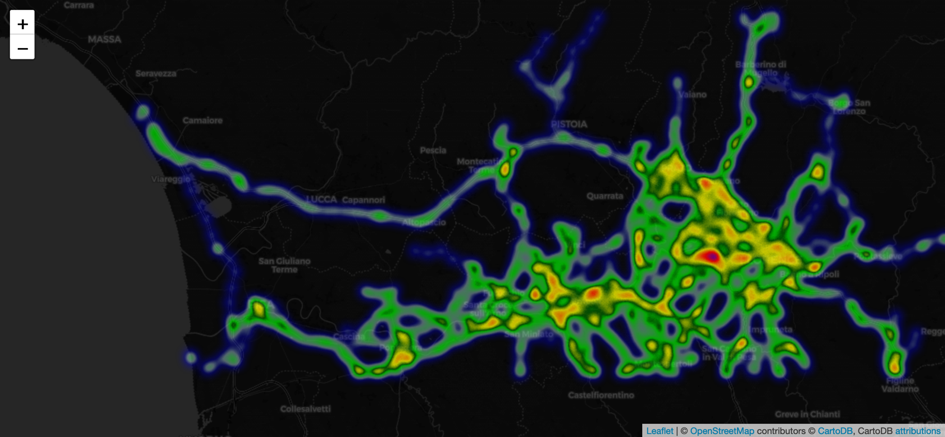
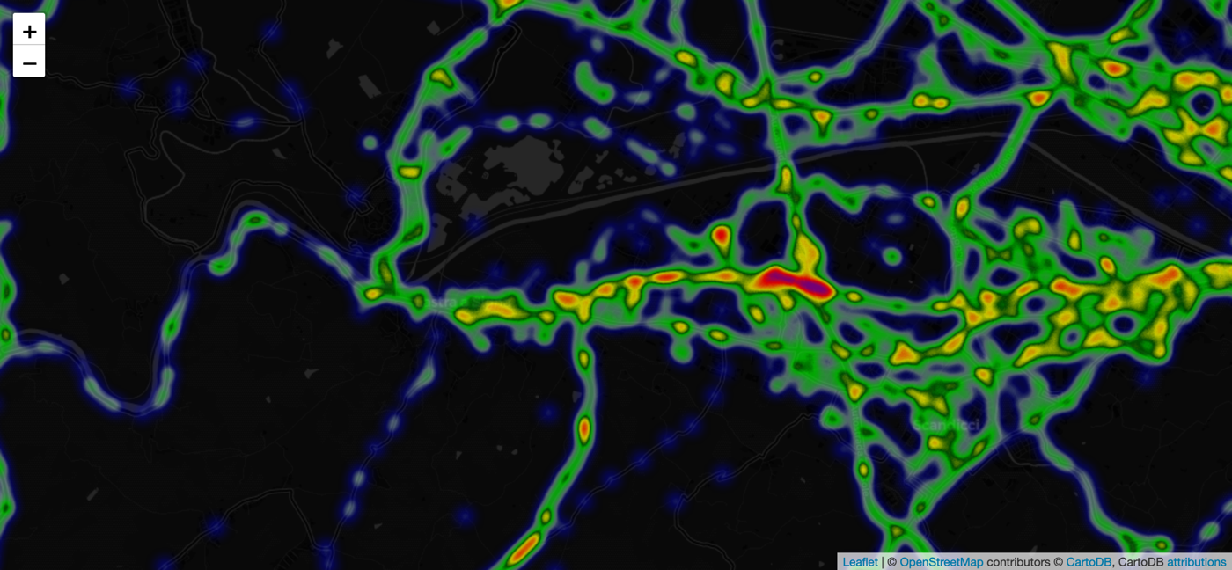
Visualising Traffic: Dynamic Insights
Heatmap
Toward Data-Driven Mobility: Harnessing Big Data for a Smarter Transport Network in Tuscany
3rd March 2025

Slide 24
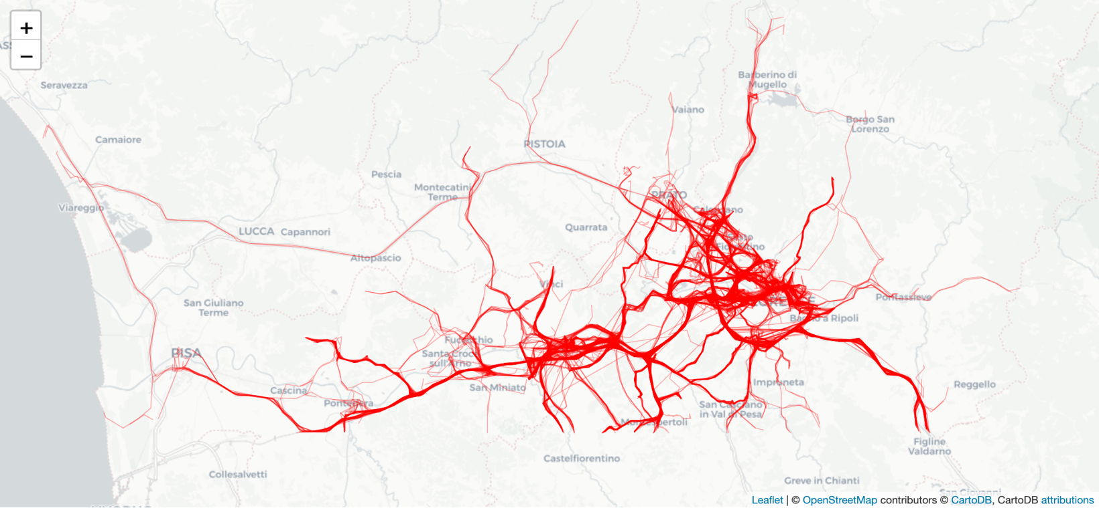
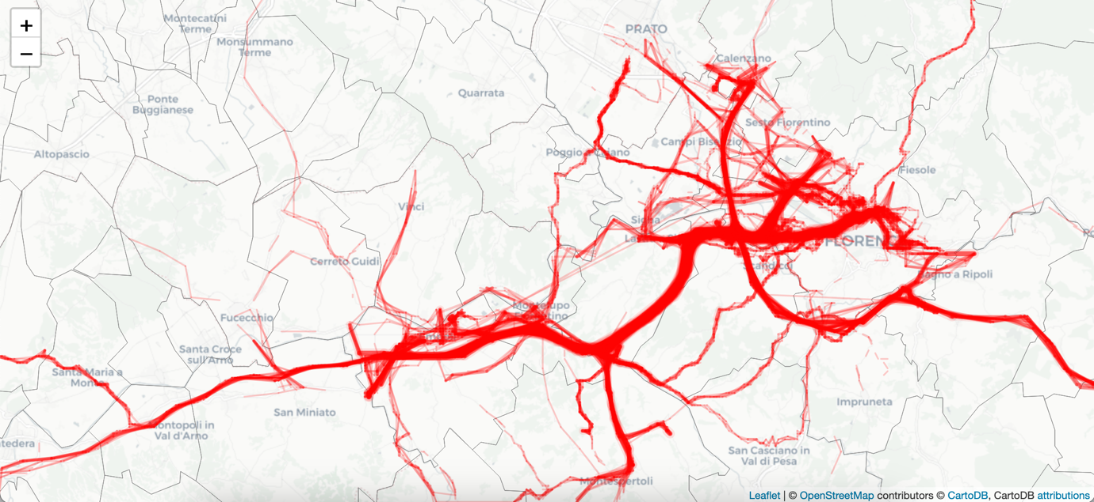
Visualising Traffic: Dynamic Insights
Trajectories
Flows
Toward Data-Driven Mobility: Harnessing Big Data for a Smarter Transport Network in Tuscany
3rd March 2025

Slide 25
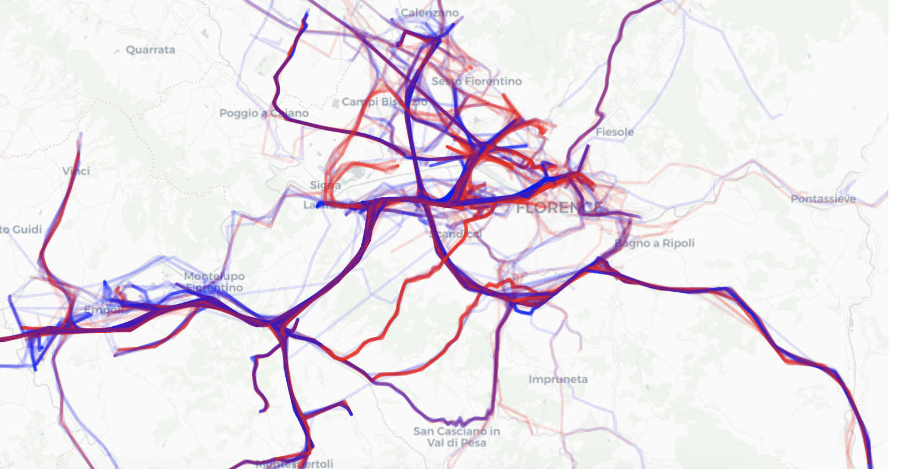
Visualising Traffic: Dynamic Insights
Inbound vs Outbound
to Florence
Toward Data-Driven Mobility: Harnessing Big Data for a Smarter Transport Network in Tuscany
3rd March 2025

Slide 26
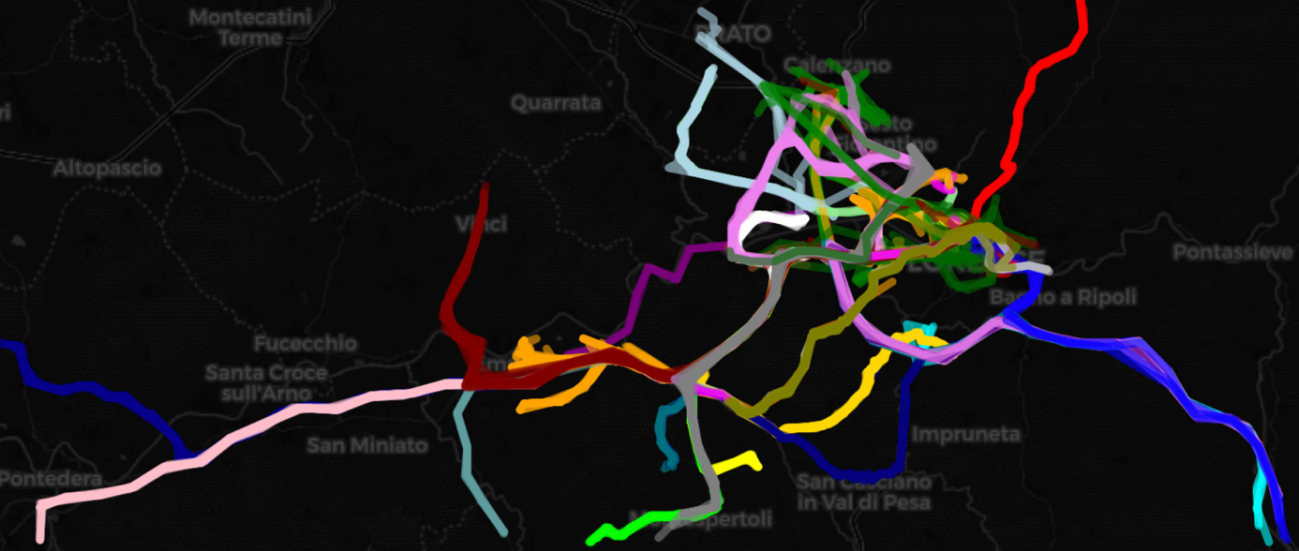
Visualising Traffic: Dynamic Insights
Clustering of Trajectories going into Florence
Toward Data-Driven Mobility: Harnessing Big Data for a Smarter Transport Network in Tuscany
3rd March 2025

Slide 27
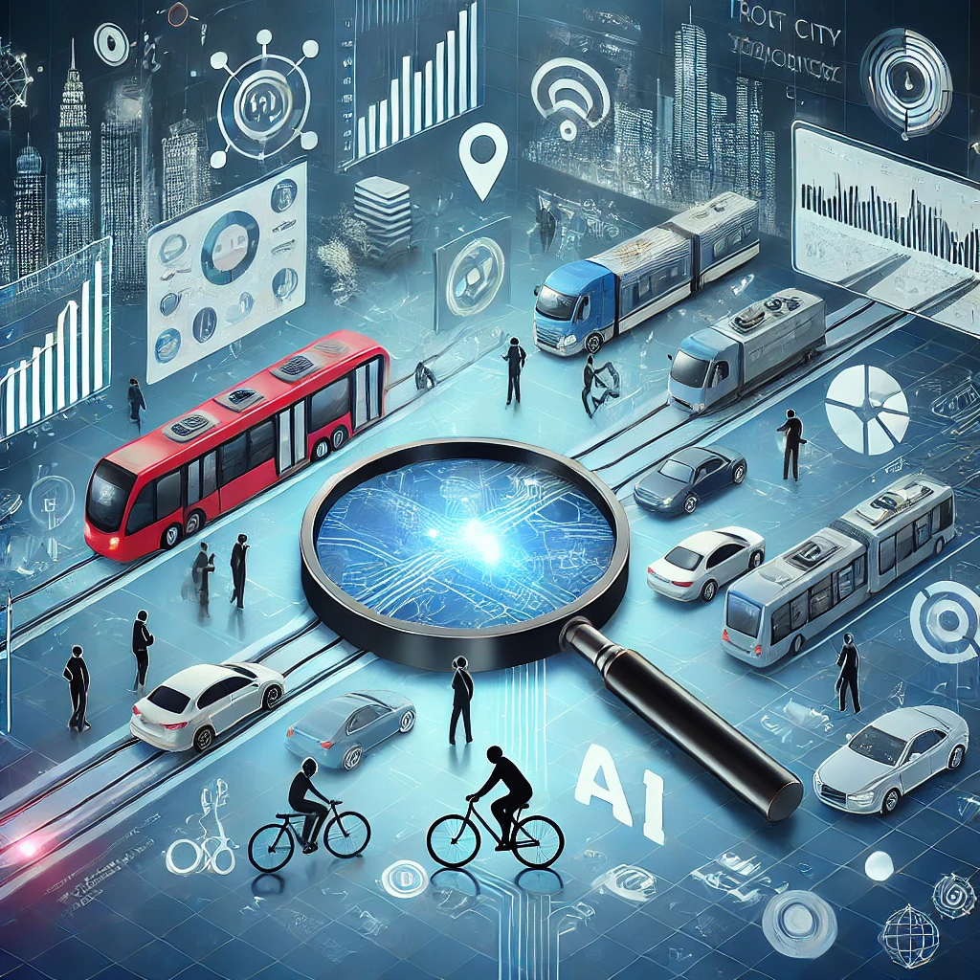
Toward a Data-Driven Mobility
Data-Driven Mobility - Advancements in Big Data, GIS, and machine learning enable authorities to track mobility patterns, optimising mobility and reducing inefficiencies to create more sustainable and equitable transport networks.
Transformative Potential of Big Data - This project highlights the unparalleled transformative power of Big Data, a force that has the potential to reshape and improve everyone’s life.
Toward Data-Driven Mobility: Harnessing Big Data for a Smarter Transport Network in Tuscany
3rd March 2025

Slide 28

Future research
Improve the identification of commuters
Refining Clustering Techniques
Analysing Speeds and Disruptions
Integrating Sensor Data
Predictive Modelling with AI
Cost-Benefit Analysis
Combining Different Datasets
Toward Data-Driven Mobility: Harnessing Big Data for a Smarter Transport Network in Tuscany
3rd March 2025

Slide 29

Toward Data-Driven Mobility: Harnessing Big Data for a Smarter Transport Network in Tuscany
3rd March 2025

